Slide 1
DISEASE PREDICTION
Presentation by Nana Yaa

Slide 2
Importing files and packages
Working with Google colab
Import necessary python packages and library
Import the necessary files i.e. train_data.csv and test_data.csv

Slide 3
Data cleaning
Perform data cleaning by removing a missing and/or null values i.e. drop rows with missing values
Convert the disease column to numerical where healthy persons are classified as non-diseased hence a value of 0
Persons with other diseases such as Diabetes, Thalasse, and Anemia are classified as diseased persons hence a value of 1.

Slide 4
Other steps
Other columns represent the features and while the disease column represent the targets.
Split dataset into x_train, y_train, x_test, and y_test where x_train, x_test are the features and y_train, y_test are the targets
Perform feature scaling on features.

Slide 5
Model training and evaluation
Train data on three different models i.e.: logistic, Random forest, and XGBoost.
Each model’s performance can be evaluated using appropriate evaluation metrics such as accuracy, precision, recall, and F1-score.
Visualize the performance of each model using confusion matrices

Slide 6
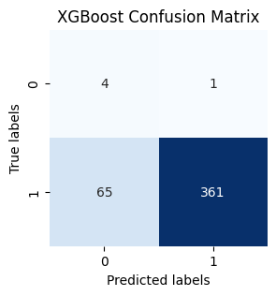
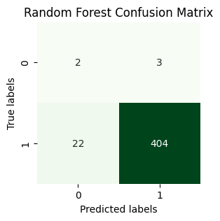
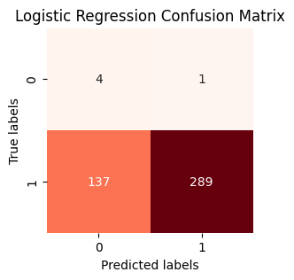
Visualization

Slide 7
Conclusion
At the end of the project the random forest model was selected as best to classify diseased and non-diseased persons with 94.2% accuracy.
A model with the highest accuracy, better precision, moderate recall and a best f1-Score compared to other models.

Slide 8
THANK YOU

